Slide 1

Tech shuttle
If not us, who?

Slide 2
Mastermind
Amrita Neekhara
Chaitanya Kulkarni
Rajat Paliwal
Shubham singh rawat

Slide 3
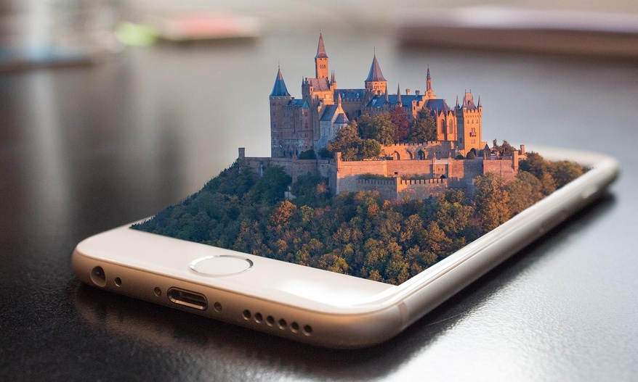




Slide 4
Resources
Github: https://github.com/techshuttle/walkietalkie
Linkedin Group: https://www.linkedin.com/groups/8927935/

